Slide 1

Marcia J. Bunge, Ph.D.
Professor of Religion, Bernhardson Endowed Chair
Nurturing the Spiritual and Religious Lives of
Children and Youth:
Why and How
Journeys in Child Theology: Lessons, Recent Work,
Future Directions
(you, me, the church)

Slide 2
Questions (you and me):
What prompted you to focus your attention on children?
What lessons and areas of inquiry have strengthened your work with and on behalf of children?
What is your current work? What new directions do you want to pursue?
In your context: How do robust theologies of childhood and child theologies strengthen the church and help all children thrive?

Slide 3
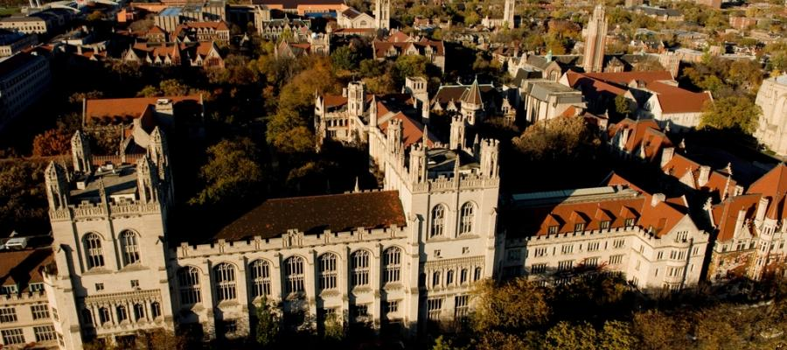
Story and Research
Ph.D.- Theology. U. of Chicago, Tübingen
Subject of children? Marginal!
“Beneath” serious theologians!

Slide 4

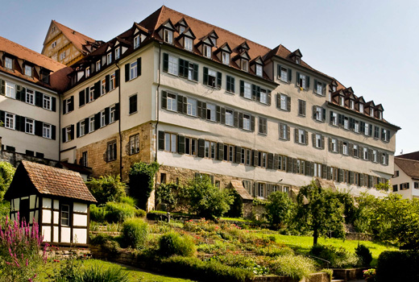
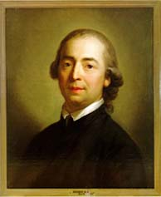
GERMANY:
Tübingen, Leipzig, Halle, Bonn, Weimar
First Book: Translation of J.G. Herder
Taught in East Germany
Lived in the Stift

Slide 5
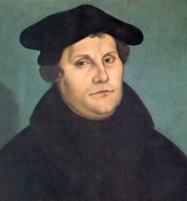
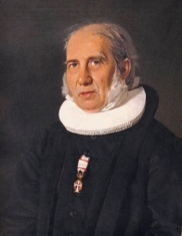
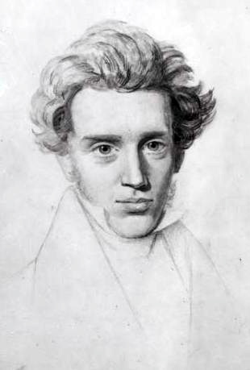
LUTHERAN THEOLOGY (cont.) and
Diverse Lutheran Traditions Globally
Germany
Norway
Denmark
Research on Grundtvig, Luther, SK
BUT ALSO Lutheran communities:
Ethiopia! South Africa! Tanzania! Kenya!

Slide 6
Beginning:
Asking the questions, becoming child-attentive
Nurturing the Spiritual and Religious Lives of
Children and Youth:
Why and How

Slide 7


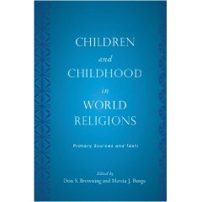
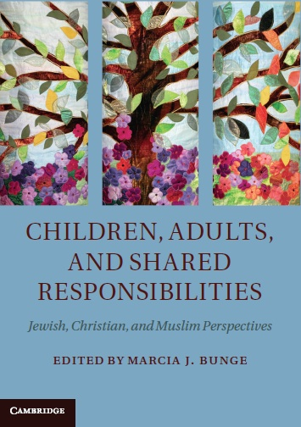

Once I had children and started teaching, I wondered why!
My theology and research shifted, became
less “adult-centered” and
more “child-attentive.”
Subject of children? Central topic!
Bible, the church, world religions!

Slide 8
FIRST CHILD-FOCUSED BOOK
Explored simple,
Powerful questions:
Who/what are children?
What do we owe them?

Slide 9
ONE: Robust Theologies of Childhood
Nurturing the Spiritual and Religious Lives of
Children and Youth:
Why and How

Slide 10
Key take-aways from early research:
Robust theologies are foundational— key—to helping children thrive!
Have many positive implications for children, the church, communities.

Slide 11
THEOLOGIES OF CHILDHOOD
Raise two important questions:
1. Conceptions of Children?
2. Commitments to Them?
The two are highly interrelated!
Strong conceptions of children and strong commitments to them go hand in hand!
.

Slide 12
THEOLOGIES OF CHILDHOOD
Strong theologies articulate multi-faceted, multi-dimensional perspectives of children and childhood, building on:
1. The Bible
2. The Christian tradition
3. Other disciplines
4. Experience

Slide 13
Saw the power of theologies that hold onto BIBLICAL PARADOXES, seeing children as:
  Fully human and made in the image of God yet also still developing and in need of instruction and guidance.
  Gifts of God and sources of joy yet also social agents capable of selfish actions.
  Vulnerable and in need of protection yet also strong, insightful models of faith and endowed with gifts to serve others.

Slide 14
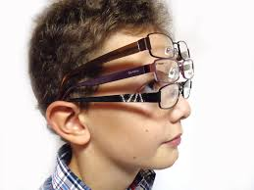

Keeping in mind this view and Jesus’ example fosters meaningful and warm relationships.
With robust theologies of childhood, we switch from Mono-focal, Adult-centered to Multi-focal, Child-inclusive lenses!
We strengthen commitments, relationships!
Notes:
And it is REWARDING!

Slide 15
TWO: Child Theology Movement and International Christian Initiatives
Nurturing the Spiritual and Religious Lives of
Children and Youth:
Why and How

Slide 16
Learned from the important work of
  Child Theology Movement (Keith White, John Collier, Haddon Willmer)
  Godly Play Foundation (Berryman)
  Fostered Connections with:
  Child Development Training and Research Center in Addis (Shiferaw Woldmichael)
  Leaders in South Africa (NW University)
  Holistic Child Development Programs (Philippines, Penang)
  Compassion International

Slide 17
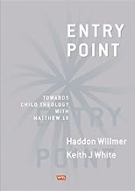
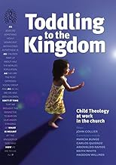
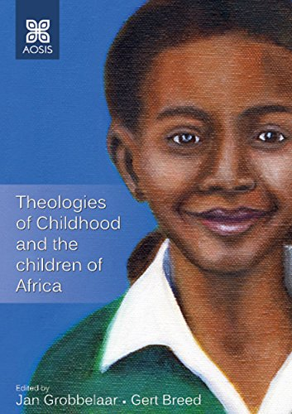
Ongoing Work in Theologies of Childhood Worldwide

Slide 18
Nurturing the Spiritual and Religious Lives of
Children and Youth:
Why and How
THREE: Child-attentive Theology across DOCTRINES, PRACTICES

Slide 19
Theologies of childhood call us to:
Expand our vision!
Rethink not only our views of children but also MANY CENTRAL doctrines and practices in the light of attention to children and childhood.
Develop CHILD-ATTENTIVE THEOLOGIES that strengthen our commitments to children and our theology as a whole!

Slide 20
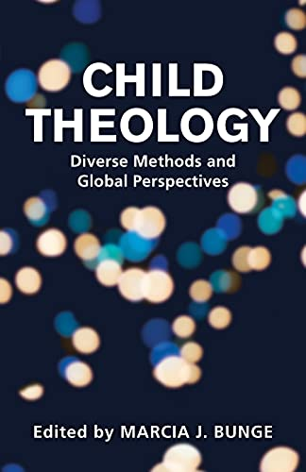
Like other liberating theologies,
CHILD-ATTENTIVE or
CHILD THEOLOGIES:
Build on Diverse Sources:
Bible, tradition, insights from other disciplines.
Re-examine:
A range of doctrines, practices with attention to the experience of the marginalized or exploited
—in this case children.

Slide 21
SOME EXAMPLES
Rethink with attention to children:
Priesthood, ordained ministry
(roles, authority, celibacy)
The Church
(children are part of the body)
The Holy Spirit
(children are also spirit-filled)
Discipline
(not same as corporal punishment)
ENRICH THEOLOGY as a whole and empower the church’s work in the world!

Slide 22

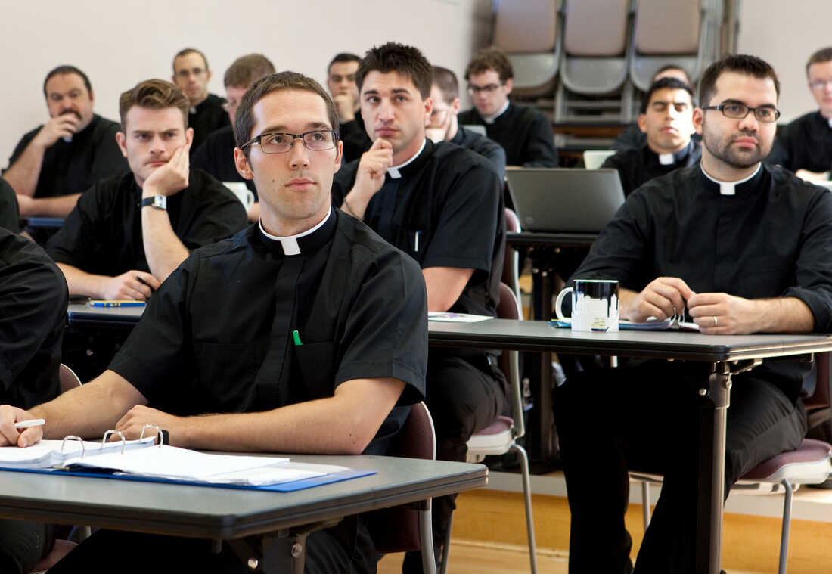
Strengthens THEOLOGICAL EDUCATION
Promotes attention to children
ACROSS THE CURRICULUM
(Biblical Studies, Church History, Pastoral Care, Systematics)
.

Slide 23
FOUR: Inter-religious Understanding and Cooperation
Nurturing the Spiritual and Religious Lives of
Children and Youth:
Why and How

Slide 24
Learning from inter-religious and interfaith projects nationally and internationally!

Slide 25
FIVE: Childhood Studies
Nurturing the Spiritual and Religious Lives of
Children and Youth:
Why and How

Slide 26

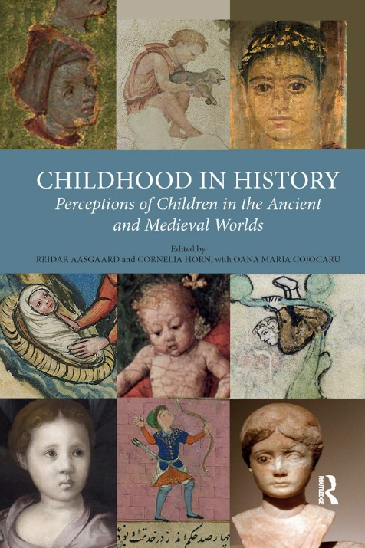
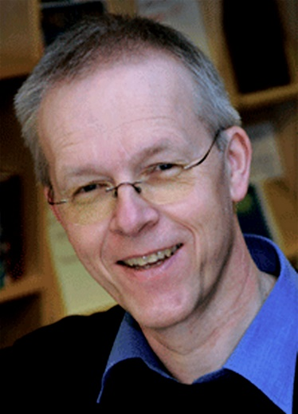
Learning from child-focused work in other disciplines and the growing field of Childhood Studies
(U of Oslo project)

Slide 27
SIX: Faith Formation and Character Development
Nurturing the Spiritual and Religious Lives of
Children and Youth:
Why and How

Slide 28
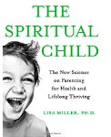


Appreciate the work of theologians and social scientists on moral and spiritual formation!

Slide 29
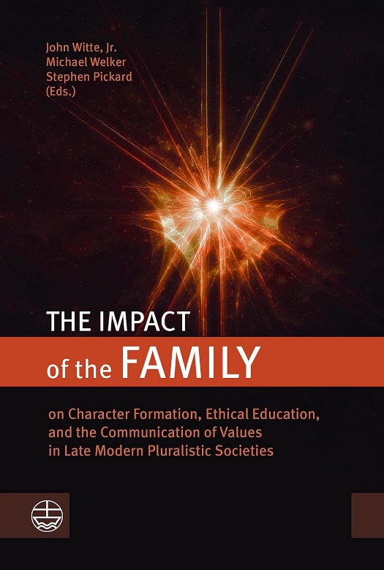

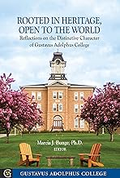
Informs work on faith formation, character development (Heidelberg, Emory), Lutheran Higher Education

Slide 30
SEVEN: Child Advocacy
Nurturing the Spiritual and Religious Lives of
Children and Youth:
Why and How

Slide 31
STRENGTHENING THE CHURCH’S PUBLIC ADVOCACY FOR ALL CHILDREN!
ENLARGING our vision beyond children’s immediate needs or the unborn and MORE INTENTIONALLY:
Addressing poverty and systemic injustices in education, health care.
Ensuring “pro-life” efforts are “pro-child” and “pro-life” across life-span.

Slide 32





Advancing Child Advocacy Efforts
(secular/faith-based/joint initiatives)

Slide 33






Supporting Faith-Based Organizations that Work with Children at Risk

Slide 34


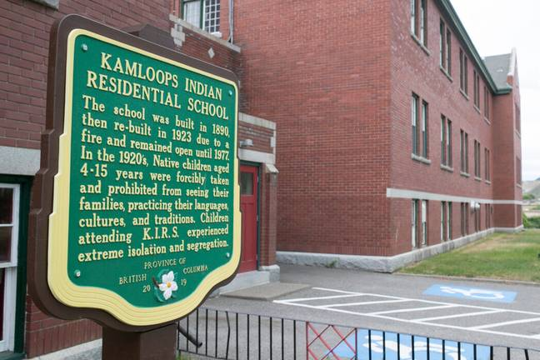
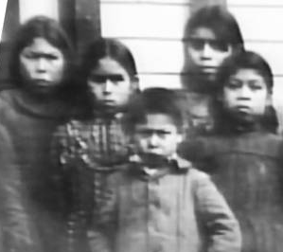
Most recent work:
Addressing Child Abuse, Neglect and Corporal Punishment of Children (past, present)

Slide 35

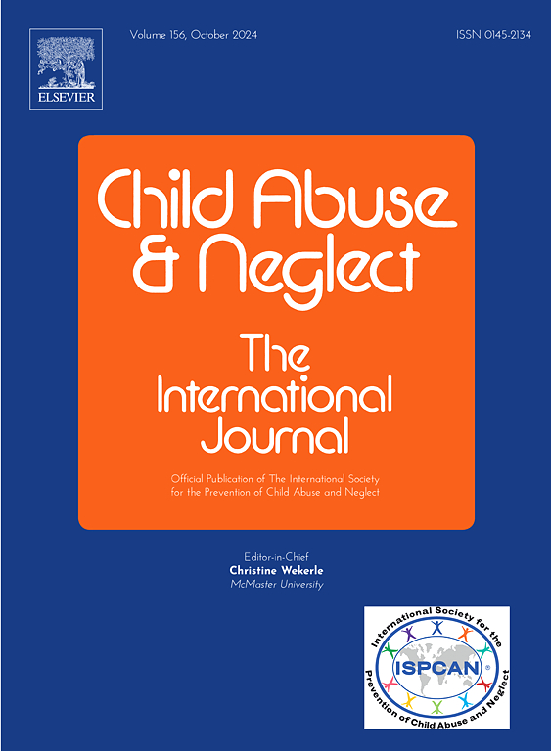
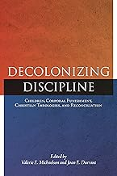
-Dangers of Spanking, Physical Punishment
-Limits of Parental Authority
-Role of the Family, Church, State
-Misuse of biblical texts, “discipline”
-Role of religious communities in child protection

Slide 36
CONCLUSION and DISCUSSION:
The Power of Honoring the Full Humanity of Children
Nurturing the Spiritual and Religious Lives of
Children and Youth:
Why and How

Slide 37
QUESTIONS FOR DISCUSSION:
What lessons and areas of inquiry have strengthened your work with and on behalf of children?
What specific doctrines or practices in your faith community might need rethinking in the light of attention to children?
How do robust theologies of childhood and child theologies that honor the full humanity of children strengthen the church and help children thrive?
What is your current work? What new directions do you want to pursue?
Invite you to write down one take-away!

