Slide 1
Child Theology and the Trauma of Children in War Zones
Keith J. White

Slide 2
Background
Russian invasion of Ukraine 24th February 2024
Conference convened by European Institute of Theology (EEIT) July/August 2023
Request for a paper addressing trauma of children in war zones rooted in experience of trauma, and within a Christian perspective

Slide 3
Shape of This Presentation
Summary of the Paper
Personal Reflections
Questions for Discussion

Slide 4
Summary of Paper
Using the typology from the book The Growth of Love…
Security…….. undermined
Boundaries……. disrupted
Significance ….threatened
Community…..dismantled
Creativity………suspended

Slide 5
Welcoming such a child in the name of Jesus
Security Safe Space offered
Boundaries Re-established
Significance Unconditional commitment
Community Building a home together
Creativity Play, Stories, Art, Dance

Slide 6
Resources (Part One) Therapy
Attunement in Learning whether at home or school
Life Stories listened to and heard
Contented adults surrounding the child
Resilience beyond understanding
Role Play
Time and Seasons

Slide 7
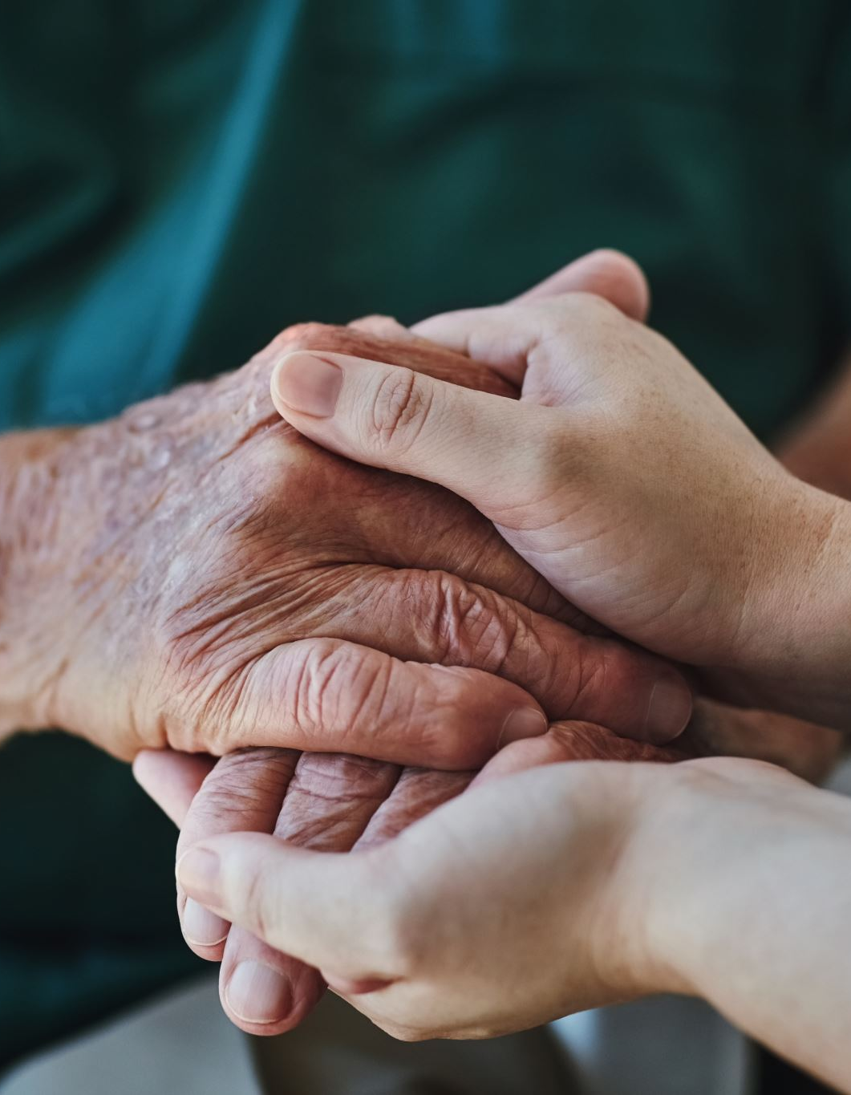
Resources (Part Two) Christian Faith
This inspires all the above and more…
The Bible
Christian households, churches, communities
Child Theology
Theologies of Suffering

Slide 8
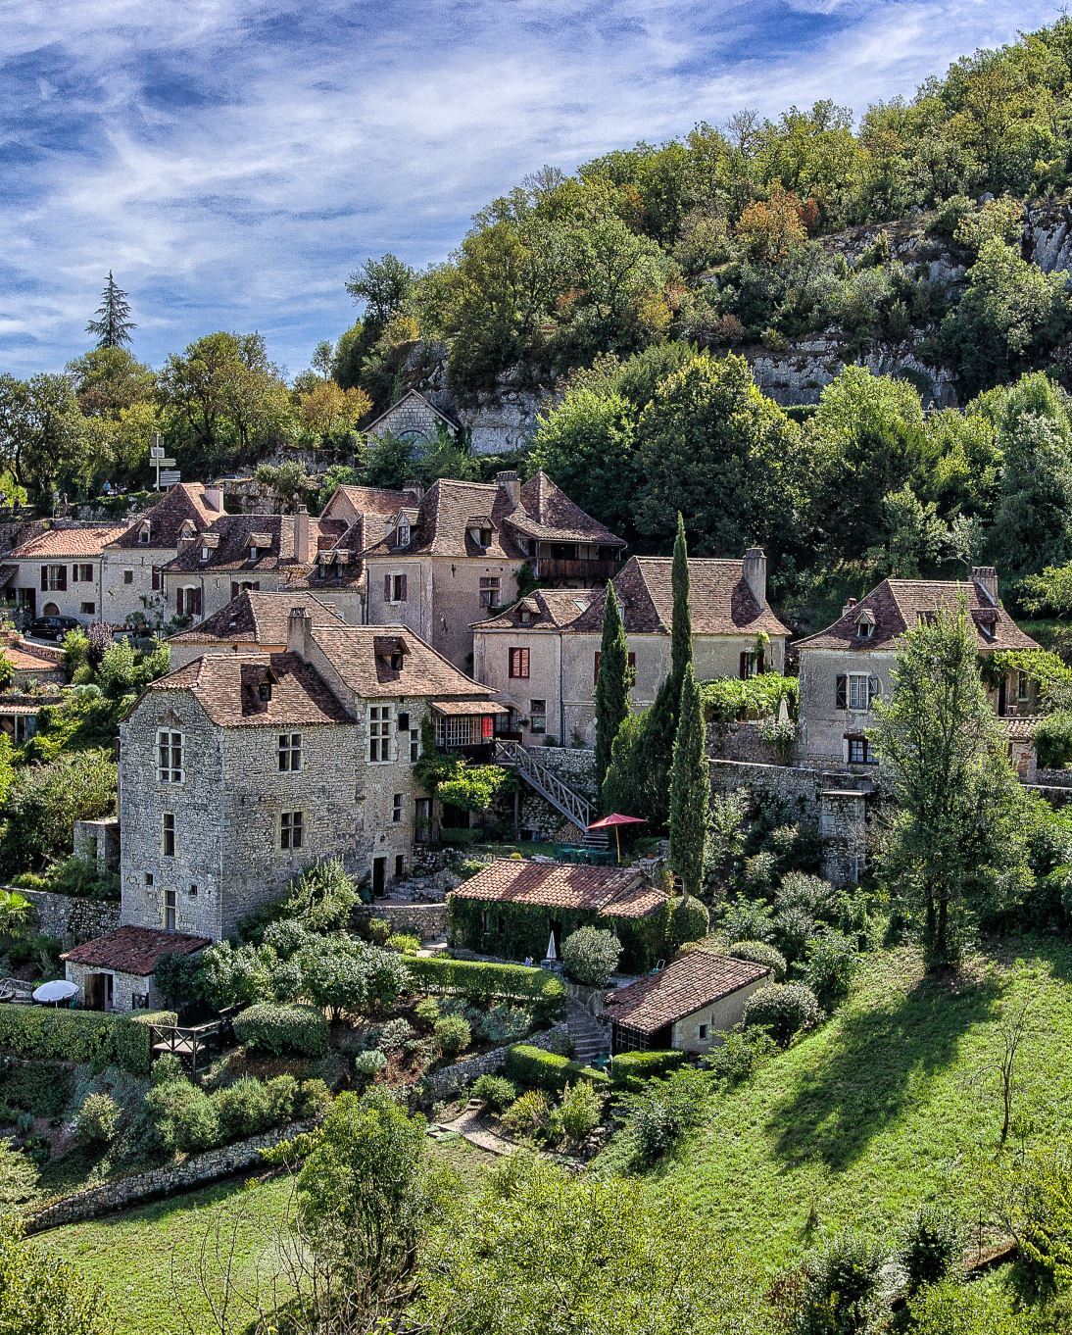
Conclusion
Christian households of faith, beyond traditional patterns…
formed by welcoming traumatised children in the name of Jesus…
like a village that begins to rebuild what has been lost through the horrors, loss and trauma of war.

Slide 9
Personal Reflections
Just two after a good deal of heart-searching…
Would silence and listening have been preferable?
Not sure it would have been possible had we not welcomed a Ukrainian family into our midst of our household in London.

Slide 10
Questions for Discussion
Head and heart in CT?
How helpful has this been?
How would you respond?
Children in hospitals?
Challenges to CT?
What else?

